Slide 1
TodoApp
A Task Management
System
Checkout our system at:
https://todo-app-main.herokuapp.com

Slide 2
Features
Personal Task list
Add/Remove/Update/Delete Tasks
Specify Due Date, Status, Priority and Labels for tasks.
Search Tasks by its Title.
Search and Filter Tasks based on Date, Priority, Status and Labels, and a combination of these.
Team
Create a team with members registered in our system.
Share tasks across all the member
Assign task to a member of a team

Slide 3
Feature(Continued)
User Authentication with Signup/Login/Logout features
Comments
Add, Delete comments on task of a team.
Email Service
Email sent when a task is assigned to a person.
Reminder email sent to the assignee, one day prior to the due date of the task

Slide 4

Tech Stack
Backend: Express.js, Node.js
Frontend: React.js
Database: MySQL
Database ORM: Sequelize
Deployment tool: Heroku
Version Control: Git
Email Service: Gmail SMTP

Slide 5
Feature
Explained

Slide 6
User Authentication
JWT token based authentication is used.
Users can sign up, login and logout from the system.
Validations checks are used on username, email and password.
Implemented middleware to check if the user is authenticated whenever a user makes a request to the server.
Added checks in the backend, making sure that a person can only view/edit tasks created by them, or of a team that they're part of. Other users are denied access.
If a user is not logged in, the system redirects the user to the login page if user tries to access private pages.

Slide 7
Personal Task list
Users can Add/Remove/Update/Delete Tasks using the system.
Users are allowed to specify the following for a task
Due Date
Status: New, In progress, Completed
Priority: Low, Medium, High
Labels: Personal, Work, Shopping, Others
Users can Search the tasks by specifying any substring of its title.
The Tasks can be Filtered based on Priority, Status and Labels, and any combination of these.
Users can Sort the tasks based on Priority and Due Date.
Validation checks are used on the title field while adding tasks.

Slide 8
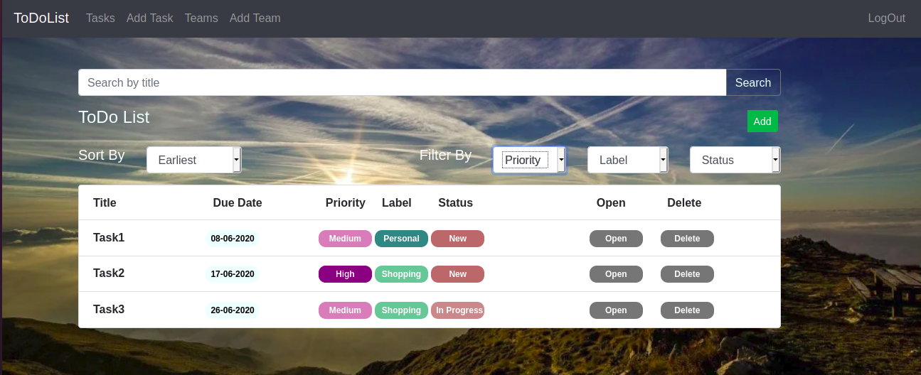
Personal Task Page

Slide 9
Teams
User can create/be a member of a team with other existing users registered in our system.
Teams can be used to share tasks across all the members.
Team members can Assign task to a member of a team
Each Team has a seperate team task list with the same functionalities of personal task list along with assigning a task to a team member.

Slide 10
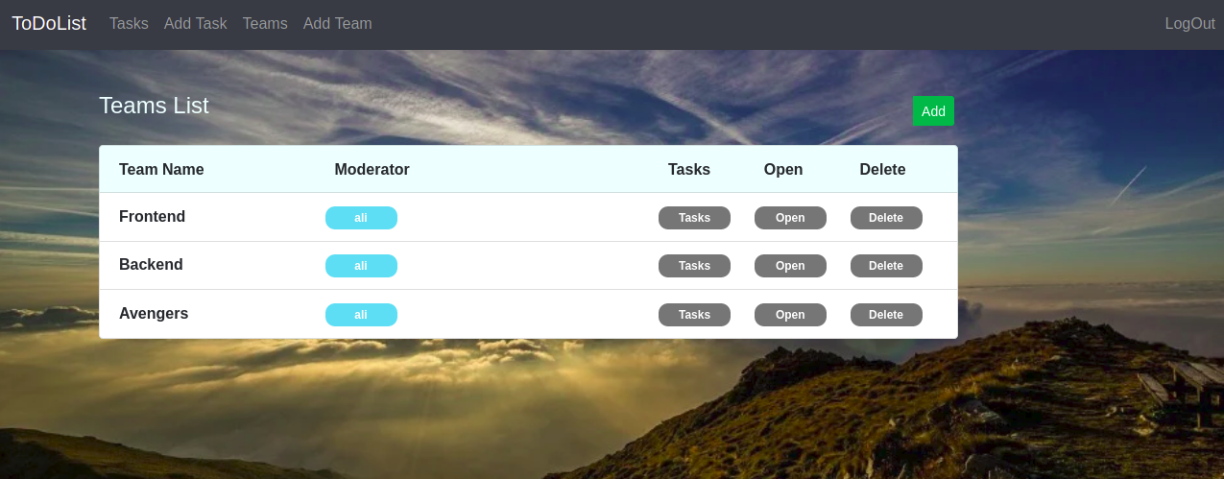
Teams Page

Slide 11
Comments
Team members can Add, Delete comments on tasks of the team created by any team member.
Comment list shows username of commenter and the created time.
Comment list appears in reverse sorted order by date-time.

Slide 12
Email Service
An email is sent when a task is assigned to a person.
A reminder email is sent one day prior to the due date of any task(for personal, team as well).
Implementation:
Used Gmail SMTP service and Nodemailer library.
Using CRON jobs to send reminder email to the task creators one day prior to the due date. [for these reminder emails, as heroku doesn't let CRON jobs run on their machine, rather it provides its own job scheduler. So we're using the Heroku job scheduler for this script]

Slide 13
Database and REST API’s

Slide 14
Database
Database
MySQL database
Database Provider
Heroku provides an addOn -> ClearDB
Database
We’ve created the database by keeping in mind normalization in databases.
We have several components of the system[Labels, Priorities, Statuses, Users, Tasks, Teams, Comments] linked to each other via relations[One to Many, Many to Many etc.]

Slide 15
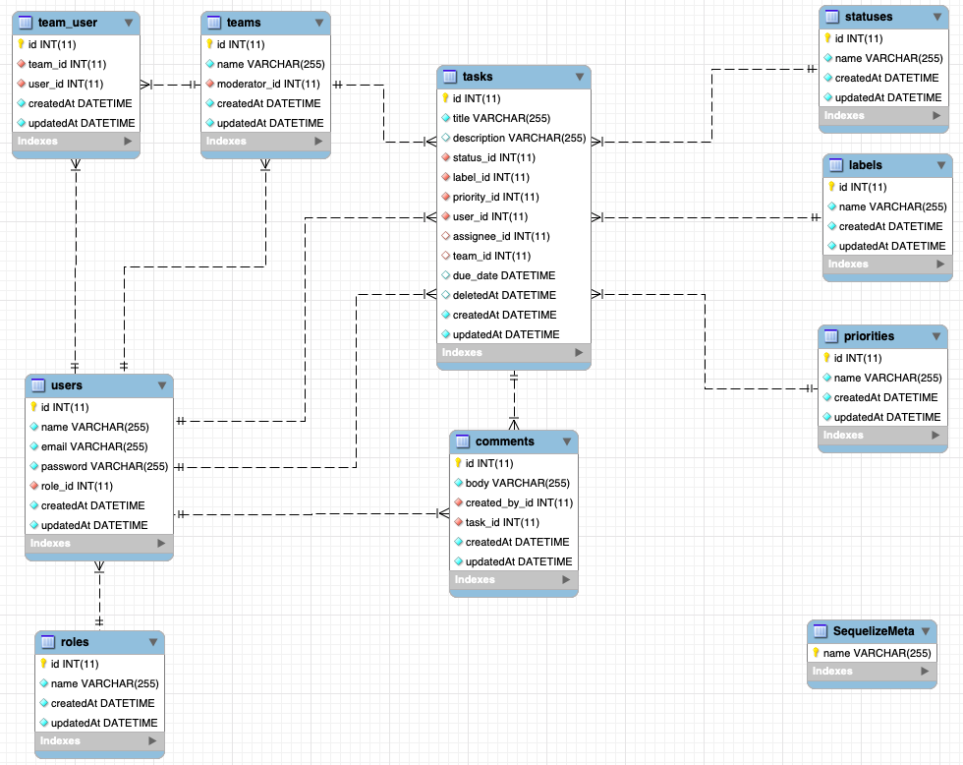
ER
Link to image
D
I
A
G
R
AM

Slide 16
Relations
You would have seen in the ER diagram that we have several relations in our database.
Example
A user can belong to more than one team and one team can have more than one user.
So we have MANY TO MANY relation between the user for that.
There are several other scenarios in the database, where we’re using other kinds of relations as well.

Slide 17
REST API’s for tasks
Method | Route | Functionality
POST | api/tasks/ | Create a task
PUT | api/tasks/:taskId | Update a task
GET | api/tasks/:taskId | Get a task with the given id
GET | api/tasks/ | Get all tasks for the user.
GET | api/teams/:teamId/tasks | Get all tasks belonging to a team
GET | api/tasks/search | Search Task by a title
DELETE | api/tasks/:taskId | Delete a task

Slide 18
REST API’s for Seeders
Method | Route | Functionality
GET | api/labels/ | Get all Label Seeders
GET | api/priorities/ | Get all Priorities Seeder
GET | api/statuses/ | Get all Statuses Seeder
REST API’s for tasks
Method | Route | Functionality
POST | api/auth/signup | To signup the user.
POST | api/auth/sigin | To sign in the user

Slide 19
REST API’s for comments
Method | Route | Functionality
POST | api/comments/ | Create a comment
GET | api/task/:taskId/comments | Get all comments belonging to a task
DELETE | api/comments/:id | Delete a comment

Slide 20
REST API’s for teams
Method | Route | Functionality
POST | api/teams/ | Create a team
GET | api/teams/:id | Get a team with the given id
GET | api/teams/ | Get all teams for the user.
DELETE | api/team/:id | Delete a team

Slide 21
Future Scope
Integration with Github
On assigning tasks to a person, assign the github issue for that task to that person
Integration with Slack
For intra-team communication.
Send reminders of tasks on whatsapp.
Nesting of teams [Sub teams inside teams]
Invitation for joining the team to the people who're not registered into our database.

